Slide 1
ShanghaiTech University
EE 115B: Digital Circuits
Fall 2021
Lecture 15
Hengzhao Yang
November 30, 2021

Slide 2
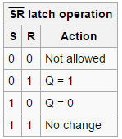
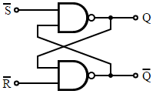

Alternate basic SR latch
Implementation: NAND gates
Set and reset are active low signals.
Left to right: circuit, circuit symbol, and characteristic table
Source: https://en.wikipedia.org/wiki/Flip-flop_(electronics)

Slide 3
Gated SR latch
Gated SR latch
  Add a signal to control the time when the set and reset signals change values
Two implementations
  NOR gates
  NAND gates

Slide 4
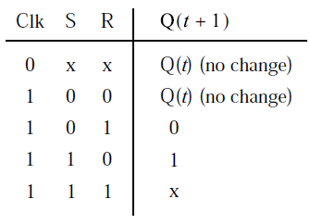
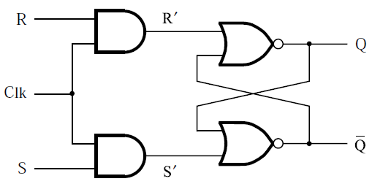
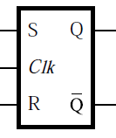
Gated SR latch with NOR gates
Control signal: Clk
  Clk=0, disabled: latched
  Clk=1, enabled: basic SR latch
  Left to right: circuit, circuit symbol, and characteristic table

Slide 5
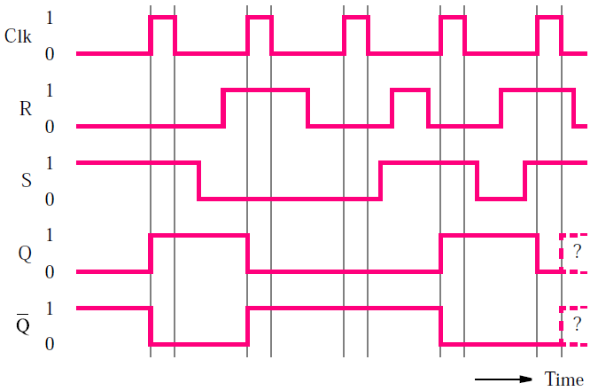
Gated SR latch with NOR gates
Timing diagram

Slide 6
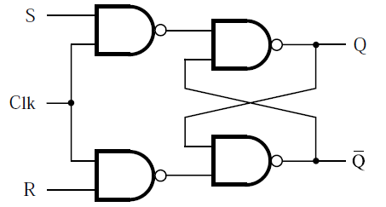
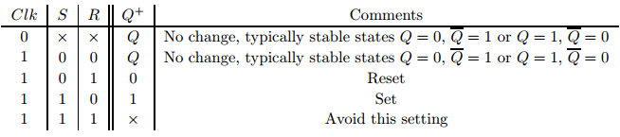
Gated SR latch with NAND gates
Circuit
Same circuit symbol and characteristic table
Source: http://ecse.bd.psu.edu/cse271/memelem.pdf

Slide 7
Summary: gated SR latch
Two implementations
  NOR gates
  NAND gates
    Preferred (requires fewer transistors)

Slide 8
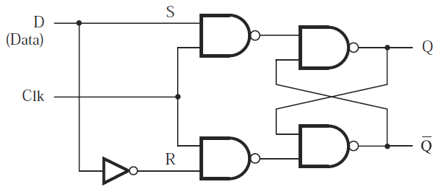
Gated D latch
Only one input: D (data)
Functionality
  Clk=1: output (Q) follows input (D)
  Clk=0: Q holds its previous value
Circuit

Slide 9
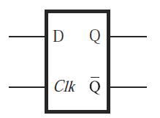
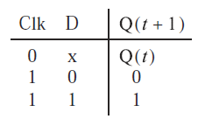
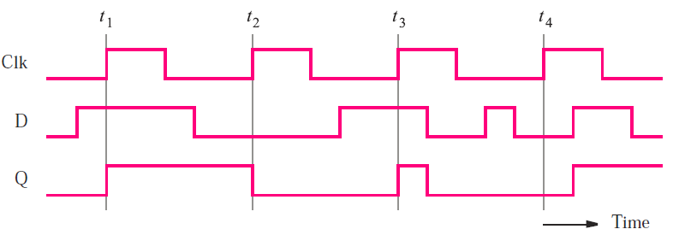
Gated D latch
Circuit symbol and characteristic table
Timing diagram

Slide 10
Level sensitive circuits
Level sensitive circuits
  Circuit output is controlled by clock level
  Circuit output keeps changing according to inputs when clock is active
  Circuit output value may change multiple times when clock is active
Examples
  Gated SR latch
  Gated D latch
  Clock is active high: Clk=1

Slide 11
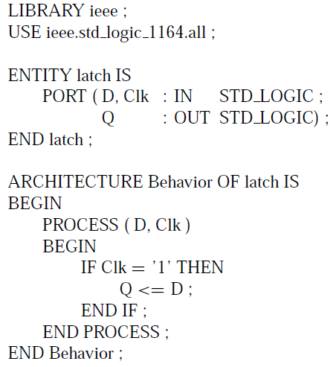
VHDL code for gated D latch

Slide 12
Flip-Flops
Edge triggered circuits
  Output only changes at clock edges (i.e., clock changes from one value to the other)
  Positive edge: clock changes from 0 to 1
  Negative edge: clock changes from 1 to 0
  Output value changes no more than once during one clock cycle
Examples
  D flip-flop
  T flip-flop
  JK flip-flop

Slide 13
D flip-flops
Operation
  Output follows input at active clock edge
Implementations
  Master-slave D flip-flop
    Output changes at negative edge of clock
    Output changes at positive edge of clock
  Edge-triggered D flip-flop
    Positive-edge-triggered
    Negative-edge-triggered

Slide 14
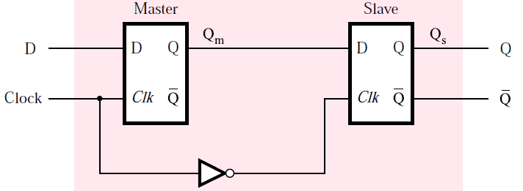
Master-slave D flip-flop: negative edge
Master-slave D flip-flop: negative edge
  Built on 2 gated D latches: master and slave
  Clock: original for master and complement for slave
  Output changes at negative edge of clock

Slide 15
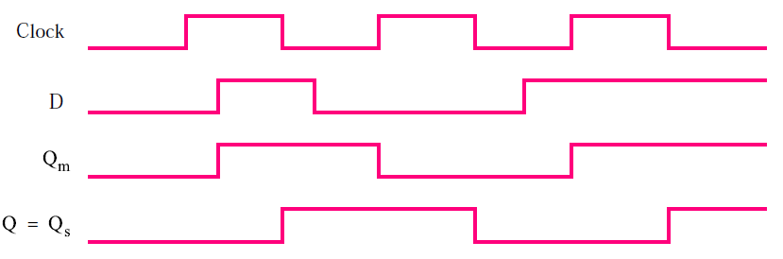
Master-slave D flip-flop: negative edge
Operation and timing diagram
  While Clock=1
    Master is active
    Q_{m} follows D
    Q_{s} remains unchanged
  While Clock=0
    Slave is active
    Q_{s} responds to Q_{m}, Q (final output) changes at negative edge

Slide 16
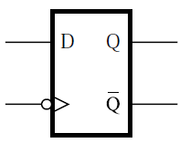
Master-slave D flip-flop: negative edge
Circuit symbol
  Symbol “>” denotes active edge of clock
  Bubble on clock indicates negative edge

Slide 17
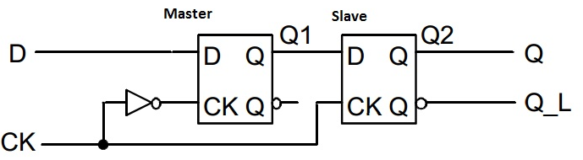
Master-slave D flip-flop: positive edge
Master-slave D flip-flop: positive edge
  Built on 2 gated D latches: master and slave
  Clock: complement for master and original for slave
  Output changes at positive edge of clock
Source: https://allthingsvlsi.files.wordpress.com/2013/04/master-slave-dff.jpg

